Slide 1
COMPARISON OF BAG OF WORDS AND TERM FREQUENCY – INVERSE DOCUMENT FREQUENCY FOR TEXT CLASSIFICATION ON NEWS CATEGORY DATASET
Twinkle Bhimani -17BCP010
Yash Bokil – 17BCP012
Tanmeet Butani – 17BCP013

Slide 2
INTRODUCTION
Natural Language Processing can be used to classify text based upon the query as required by the user. This has many applications in real world like suggestions from Google, News Classification based on category, Title suggestion for movies, songs etc.
All of these applications can be implemented using many datasets as training modules, differently developed NLP pipelines, classification methods

Slide 3
Objective
This project presents customized news suggestion according to the previous read news.
It performes Text Classification based upon the News Category Dataset available from Kaggle to show other related articles from the dataset.
To keep the differences stable, we have kept the rest of the parameters almost as same as possible for both of the methods.

Slide 4
Our Implementation
We have performed Text Classification based upon the News Category Dataset available from Kaggle to show other related articles from the dataset.
We have used two methods of text classifications to show the difference in recommended articles so as to measure the difference between the methods used for text classification.
To keep the differences stable, we have kept the rest of the parameters almost as same as possible for both of the methods.
We also discuss advantages and disadvantages of both the methods while comparing them.

Slide 5
Execution Methodology
THE DATASET
DATA CLEANING AND PREPROCESSING
-Tokenization
-Stop-Word Removal
-Lemmatization
FEATURE EXTRACTION
-Count Vectorization
-TF-IDF Vectorizer
RESULTS
CODE IMPLEMENTATION
CLASSIFICATION OF TEXT
- BaG of Words Model
- TF-IDF Model

Slide 6
Code Implementation
Reading the dataset as a pandas dataframe.
Cleaning the dataset.
Removing duplicate entries.
Filling in blank cells.
Indexing, refactoring and copying data to work on respectively.
Using tokenization and stop-word removal for pre-processing.
Using lemmatizer to reduce to the root word.
Using count vectorizer to vectorize, fit and transform dataset to train model and Bag of Words model to classify query string.
Using TF-IDF vectorizer to vectorize, fit and transform the dataset to train model and TF-IDF model to classify query string.

Slide 7
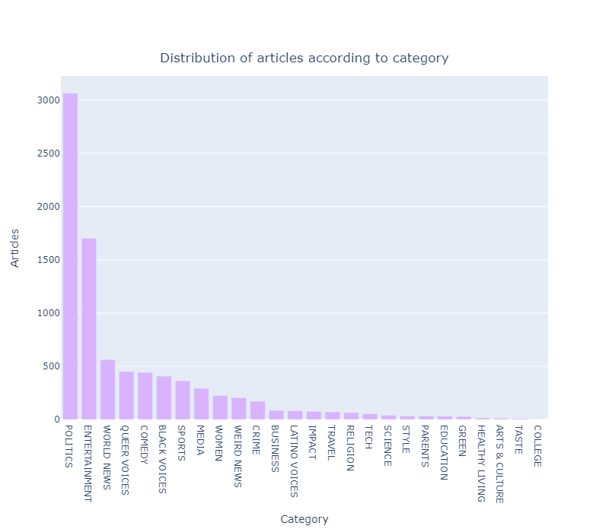
Statistical Analysis of The Data
Plot 1: Category vs Articles

Slide 8
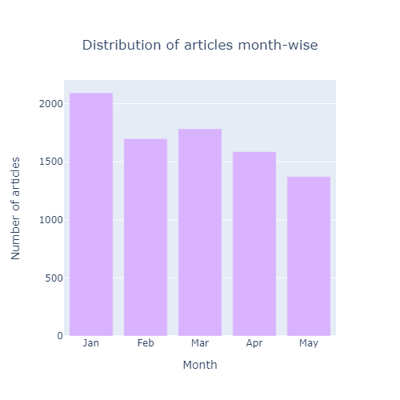
Plot 2: Month-wise distribution of articles

Slide 9
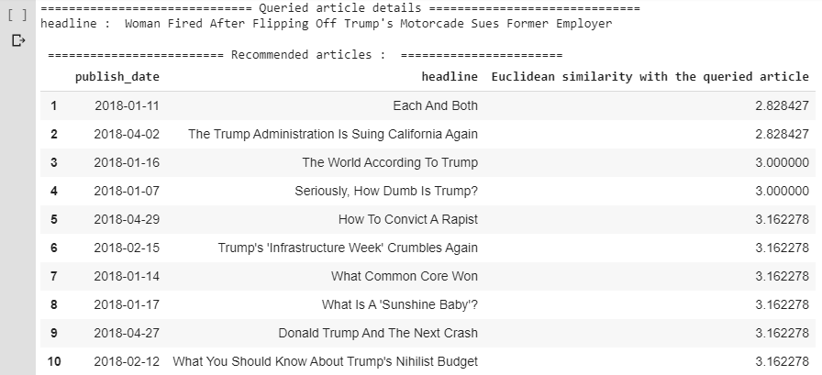
RESULTS
Bag of Words Results

Slide 10
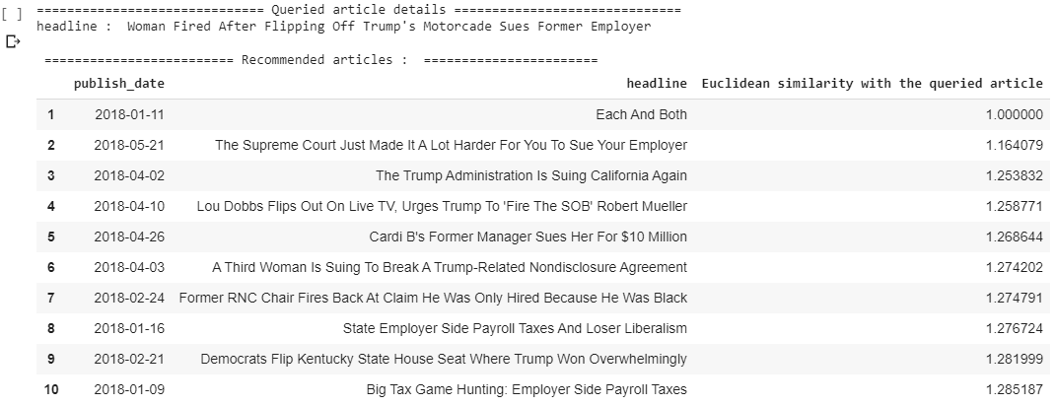
TF-IDF Results

Slide 11
Conclusion
Thus, the TF-IDF model is able to give more accurate classifications than Bag of Words, due to its implementation word wise query matching from the dataset.
Given that the training dataset (therefore supervised learning) is properly curated and parameters of training are taken care of

Slide 12
References
https://www.kaggle.com/rmisra/news-category-dataset/metadata
https://www.kaggle.com/vikashrajluhaniwal/recommending-news-articles-based-on-read-articles
https://stats.stackexchange.com/questions/153069/bag-of-words-for-text-classification-why-not-just-use-word-frequencies-insteadhttps://machinelearningmastery.com/gentle-introduction-bag-words-model/

Slide 13
THANK YOU

